Slide 1

AI Hardware Project
Edge-AI Waste Classification on OpenMV H7
Course: AI Hardware
Members: Mengzi Cheng, Shuai Tu, Sirui You, Xueyi Zhang
Team Name : Circuit Board Layout
Date: December 2025

Slide 2

CONTENTS
01
02
03
04
05
06
Platforms ＆ Team Responsibilities
Dataset & Preprocessing
Conclusions ＆ Future Works
Motivation＆ Goals
Model & Training
Deployment & Results

Slide 3
01
Platforms ＆ Team Responsibilities

Slide 4
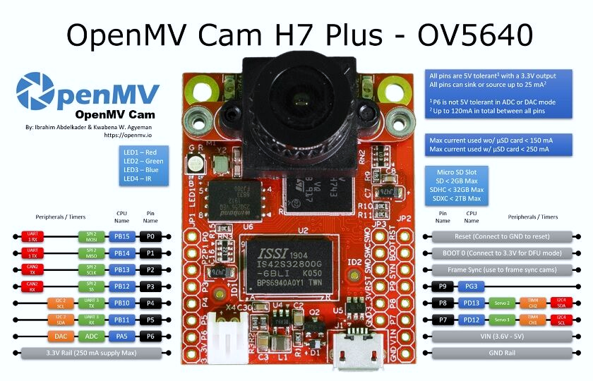
1
Platforms
Category | Key Spec | Value
Compute | MCU | STM32H743II, ARM Cortex-M7
Compute | Clock | 480 MHz
Memory / Storage | RAM / Flash (total) | 33 MB RAM / 34 MB Flash
Camera | Sensor | OV5640 (5MP, up to 2592×1944)
Camera | Lens | 2.8 mm, F2.0 (M12 mount)
Deployment | Model runtime | TensorFlow Lite (TFLite) support / OpenMV export workflow
Power | Input | VIN 3.6–5 V (3.3V logic)
Power | Current draw (active) | ~230–240 mA @ 3.3 V (with/without μSD)
I/O | Connectivity | USB FS (12 Mbps) + microSD slot
Form factor | Size / Weight | 45×36×29 mm / 17 g
Hardware Platform:
• OpenMV H7 (STM32H7 Cortex-M7 @ 480 MHz, camera module, various sensors, and support for TensorFlow Lite for Microcontrollers.)
Software:
• Edge Impulse
• OpenMV IDE

Slide 5
1
Pipeline ＆ Team Responsibilities
Project Pipeline
Dataset
Split & Upload
Preprocess
Training
Export & Deploy
Live Inference
TrashNet
Train/Val split
Resize + grayscale
MobileNetV2
OpenMV export
Camera → probs
4 types: paper / plastic / metal / glass
Upload to
Edge Impulse
96×96 input
Transfer Learning
TFLite + labels
+ FPS output
Name | Role | Responsibilities
Mengzi Cheng | Team Leader | Planning & coordination; integration oversight; presentation coordination
Shuai Tu | Hardware & Deployment | OpenMV H7 setup; device/camera configuration; on-device deployment; demo hardware support
Sirui You | Software & Integration | OpenMV scripting; inference pipeline implementation; debugging & serial/logging integration
Xueyi Zhang | Model & Documentation | Proposal writing; PPT design/editing; dataset preparation; model training & evaluation; final report submission
Week | Milestone | Deliverable
2 | Proposal | PDF + GitHub submission
4 | Midterm presentation | model quantization and benchmarking, presentation slides
6 | Integration & testing | on-device inference, FPS/latency results, robustness testing and analysis
Dec.18 | Final presentation | Final report, demo video, slides, GitHub archive

Slide 6
02
Motivation ＆ Goals

Slide 7
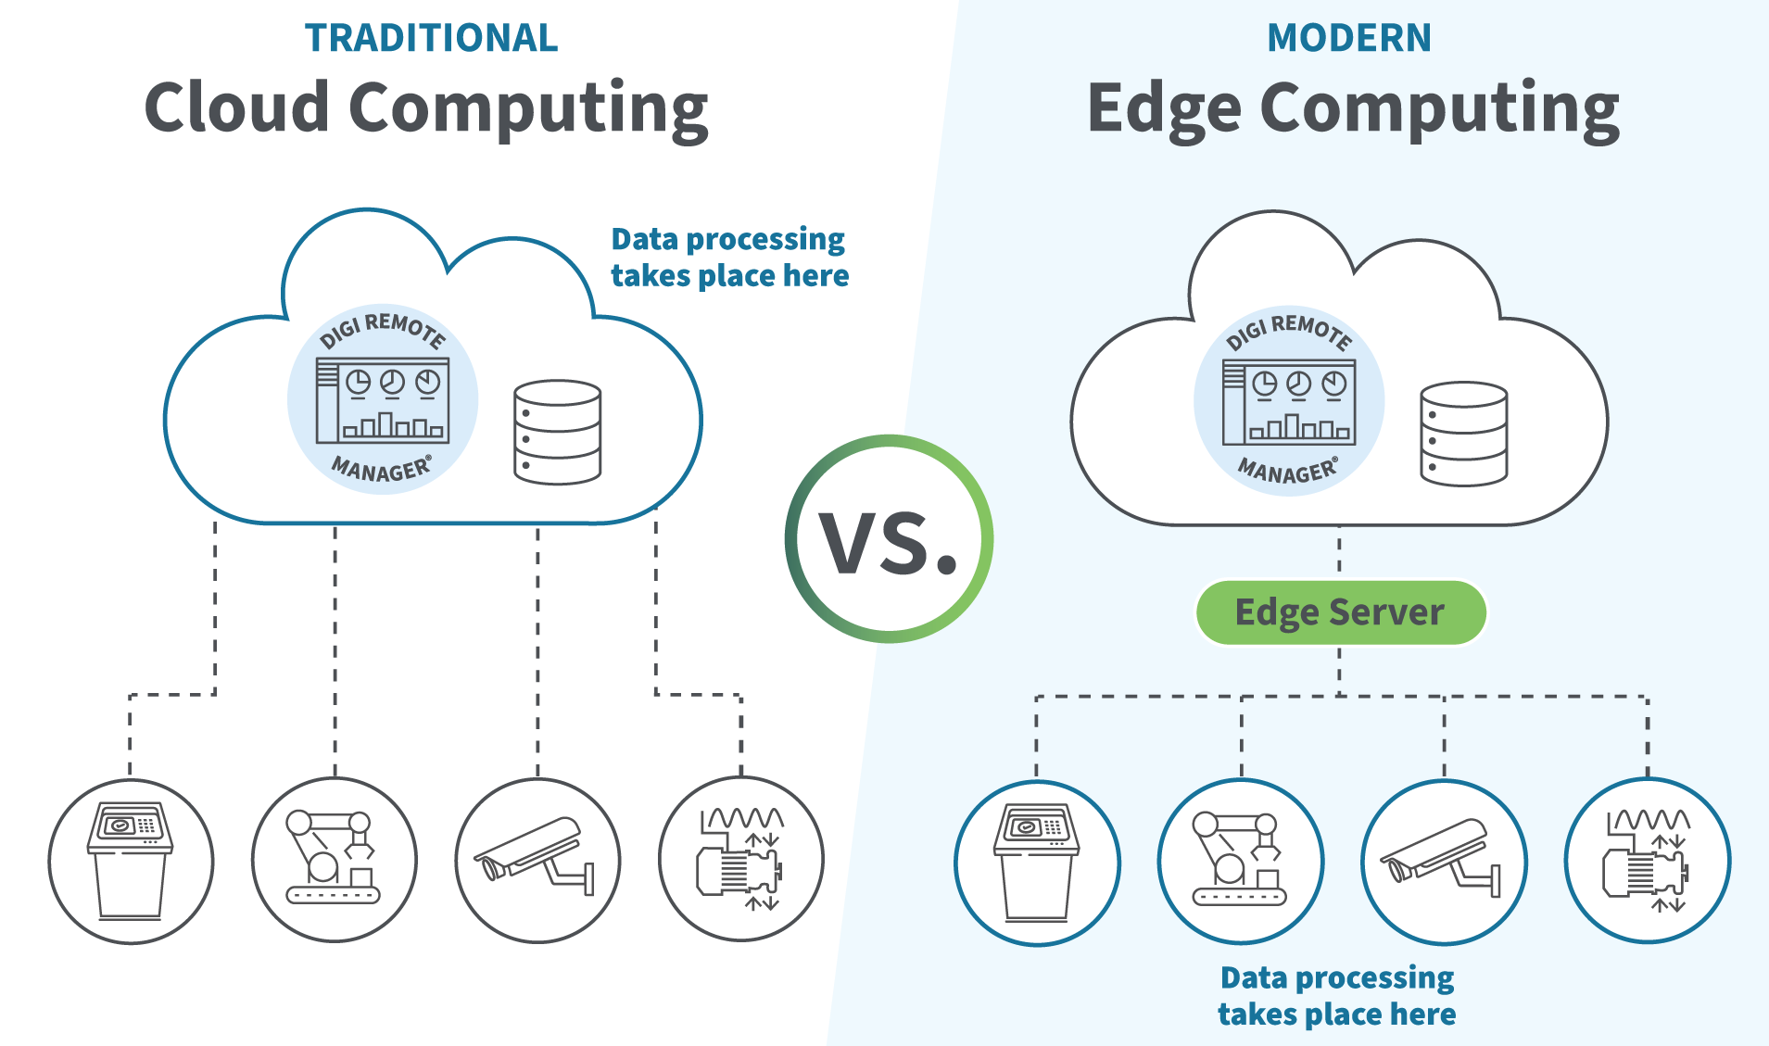

2
Motivation
Why Edge AI for Waste Sorting?
Waste Classification
Fast & reliable sorting needs real-time decisions near the bin.
Cloud inference adds latency, needs connectivity, and raises privacy concerns.
Edge inference on MCU enables low-cost, low-power, standalone deployment.

Slide 8
2
Project Goals & Success Metrics
GOAL
Build an end-to-end edge AI pipeline (dataset → training → deployment).
Deploy a waste classifier on OpenMV H7 for live camera inference.
Run fully on-device without cloud for standalone operation.
Evaluate performance under MCU constraints (accuracy, speed, memory).
Accuracy
Validation accuracy + confusion matrix
Latency/FPS
Real-time speed measured on OpenMV H7
Memory ＆ Footprint
RAM & Flash usage fits MCU limits
Robustness
Works across lighting/background with real objects
Deliverables
Model , OpenMV script , Demo video , Report, Presentation

Slide 9
03
Dataset & Preprocessing

Slide 10
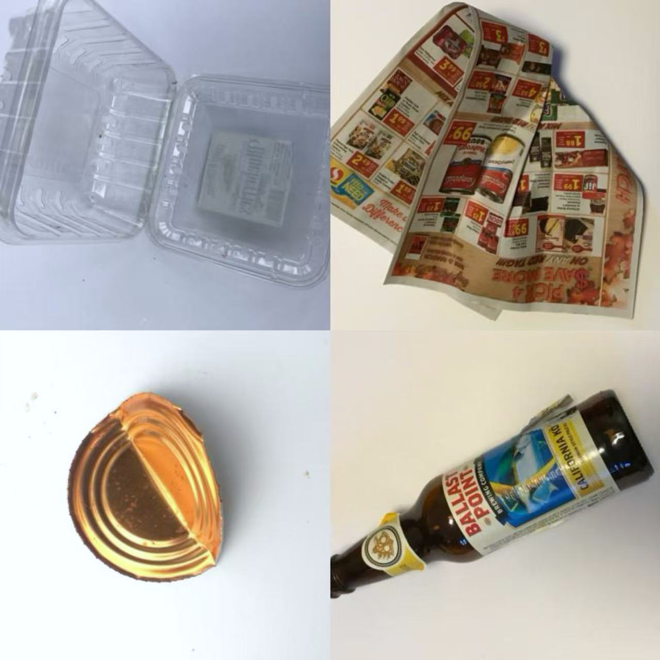
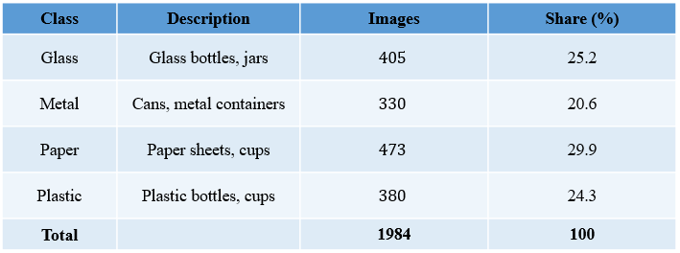
3
Waste Image Dataset – Trash Net
Source: GitHub repository
Task: Single-image multi-class classification of household waste
Classes (4): glass, metal, paper, plastic
Image resolution: 512 × 384 pixels (RGB)
Acquisition setup: Captured with iPhone cameras under room light
Total number of images: 1,984
Example images from the Trash Net
Plastic / Paper
Metal / Glass

Slide 11
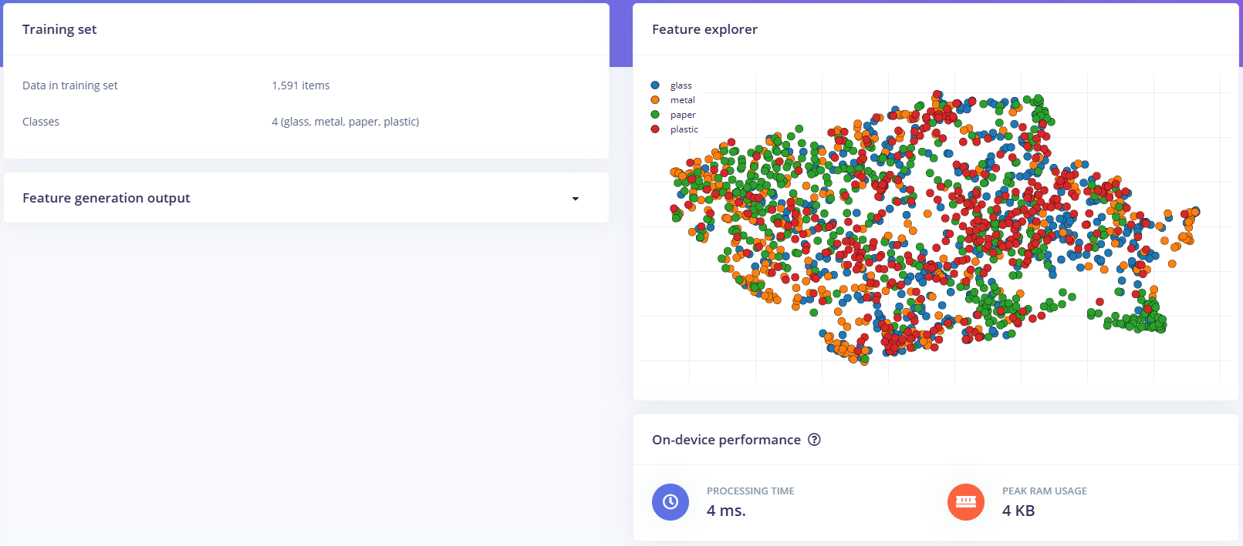
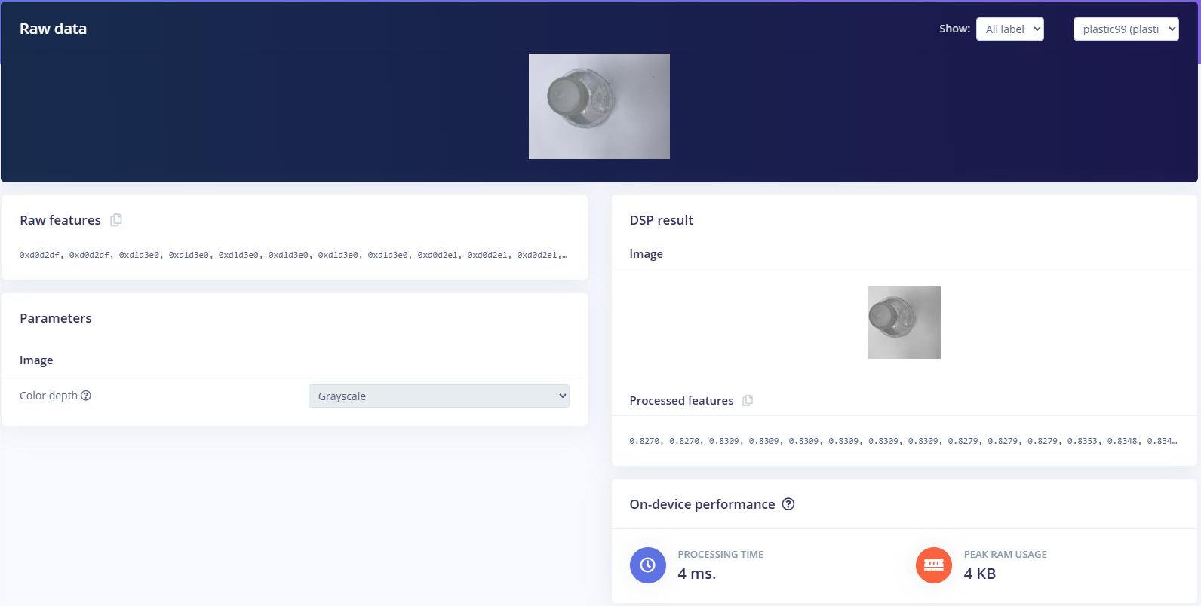
3
Data Preprocessing
Offline preprocessing
Online preprocessing
All images are RGB
Resize to 512 × 384 pixels
Store in class-specific folders (glass, metal, paper, plastic)
Resize mode: keep the original aspect ratio
Convert each 96 × 96 grayscale image into a normalized feature vector
4 ms processing time and 4 KB peak RAM usage

Slide 12
04
Model & Training

Slide 13
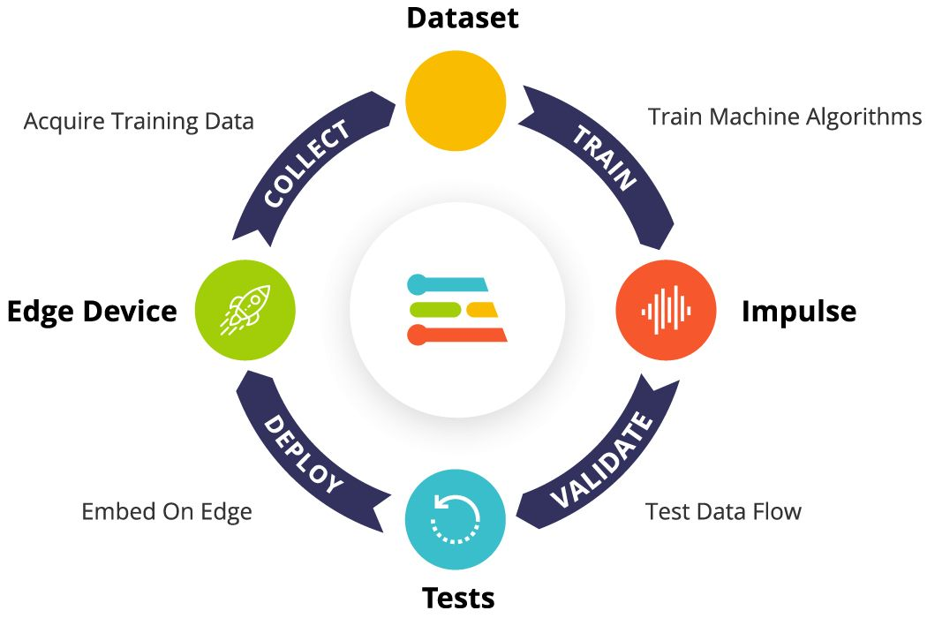
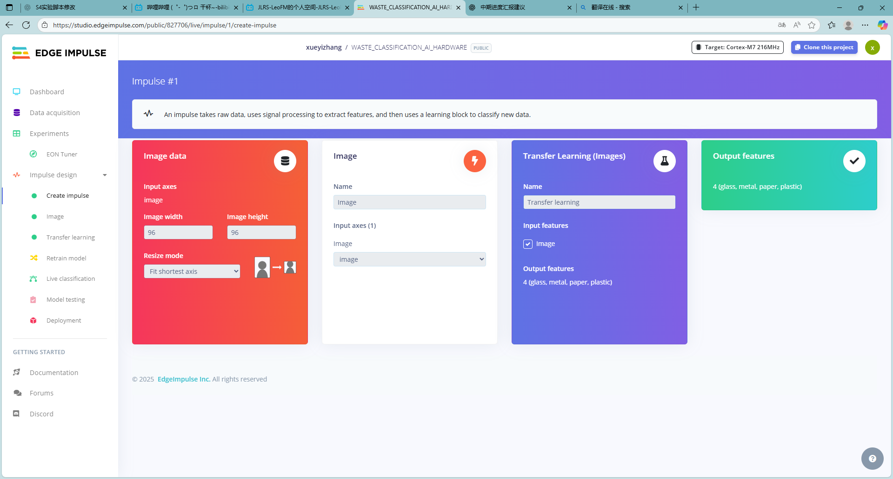
4
Edge Impulse Platform for Embedded ML
In this project, we use Edge Impulse mainly for image classification of waste.
Module | Function | Our work in this project
Data acquisition | Import and organize datasets | Upload images from Trash Net and create labels in Edge Impulse
Impulse design | Define input, preprocessing, classifier | Set image size, normalization and image classification block
Model training | Train and optimize models | Run multiple trainings and tune epochs / batch size / augmentation
Model testing | Evaluate model performance | Check accuracy, loss curves and confusion matrix
Deployment (analysis) | Prepare export for edge devices | Check memory and latency estimates for OpenMV H7 target
Use the built-in “Transfer Learning (Images)” block as the image classifier.
The model takes the image features as input and outputs 4 classes: glass, metal, paper and plastic.

Slide 14
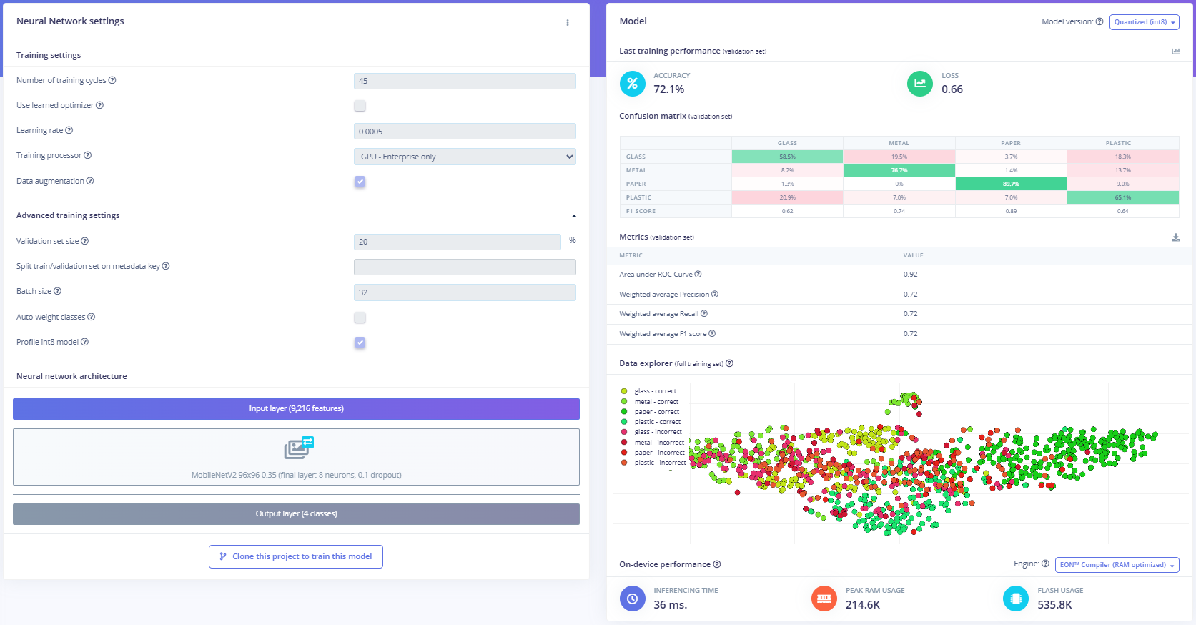
4
Model configuration & training results
Model & training settings
Backbone: MobileNetV2 96×96 0.35 (0.1 dropout)
Output: 4 classes (glass, metal, paper, plastic).
Training cycles: 45;
batch size: 32
learning rate: 0.0005.
Validation set: 20% of the data, data augmentation enabled.
Validation performance
Accuracy: 72.1%, loss: 0.66
AUC: 0.92
weighted Precision / Recall / F1: ≈ 0.72
Paper is easiest to classify (≈89.7% recall), glass and plastic remain harder.
On-device performance
Inference time: 36 ms (per image).
Peak RAM usage: ≈ 215 KB
flash usage: ≈ 536 KB.
Feasible for real-time deployment on OpenMV H7.

Slide 15
05
Deployment
＆ Results

Slide 16
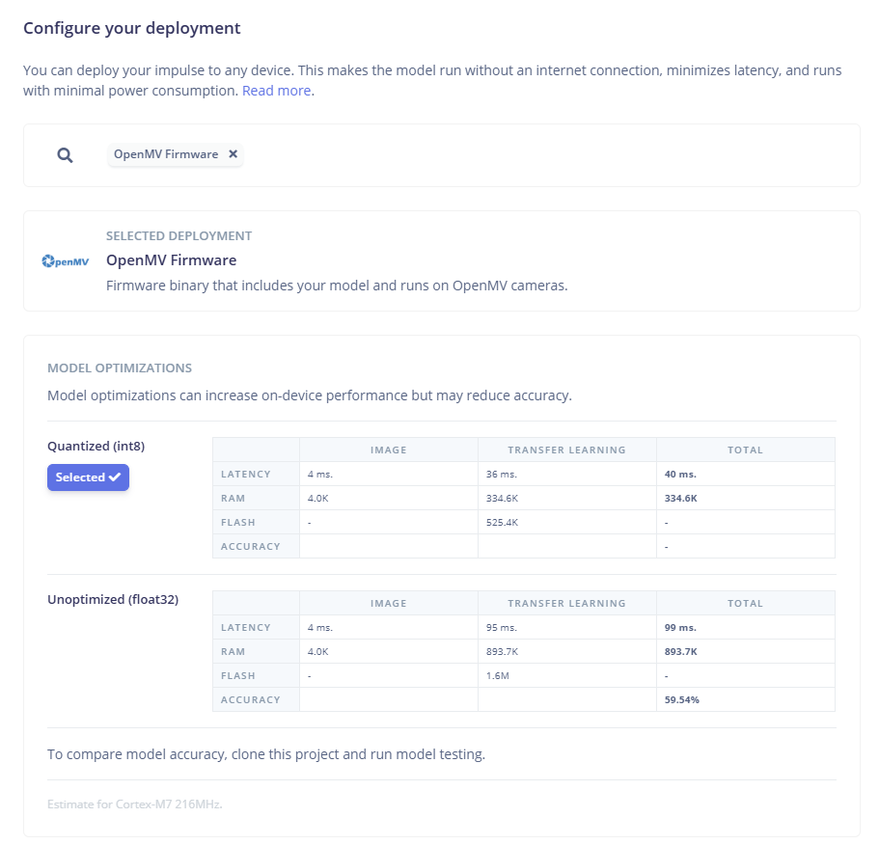
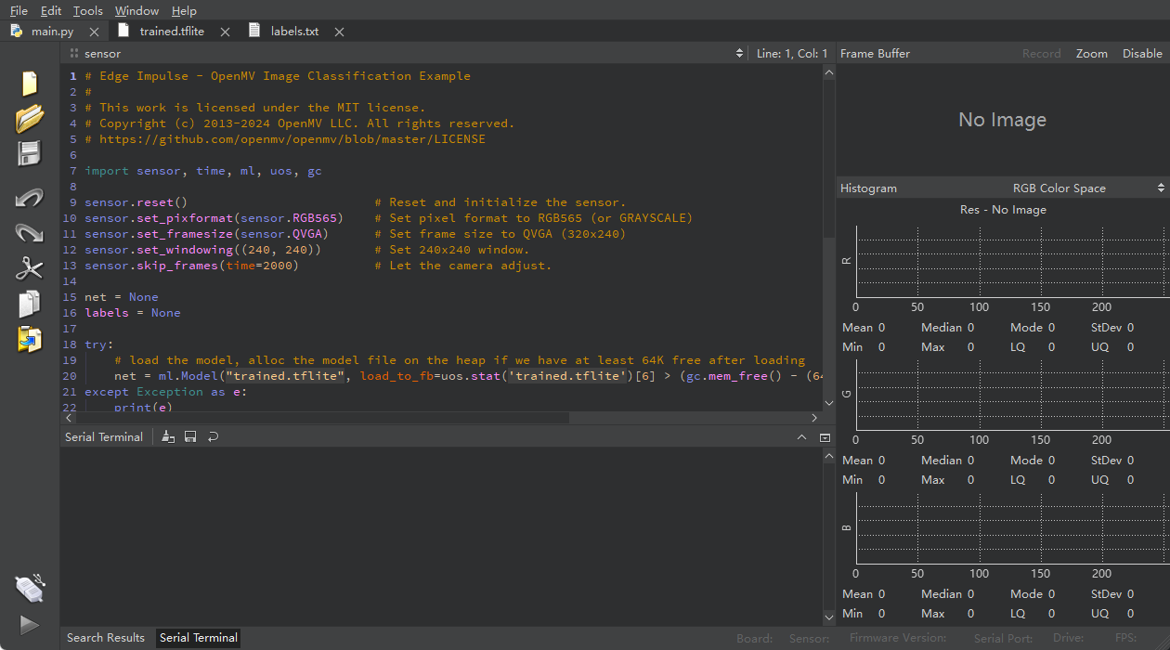
5
Model Deployment to OpenMV H7
1. Exporting the Model from Edge Impulse
Relevant screenshots
Exported as OpenMV Firmware (.tflite + labels.txt)
Ensured model size fits the H7 Flash & RAM
Downloaded via “Deployment → OpenMV” in Edge Impulse
2. Copying the model into the board
Connected OpenMV through USB
Copied trained.tflite and labels.txt to OpenMV’s file system
Verified file names match the Python script
2. Performance snapshots (Head & Tail)
3. Running the inference script
Initialized camera (RGB565, QVGA, 240×240 crop)
Loaded TFLite model using ml.Model()
Ran continuous prediction loopPrinted class probabilities and FPS through serial monitor

Slide 17
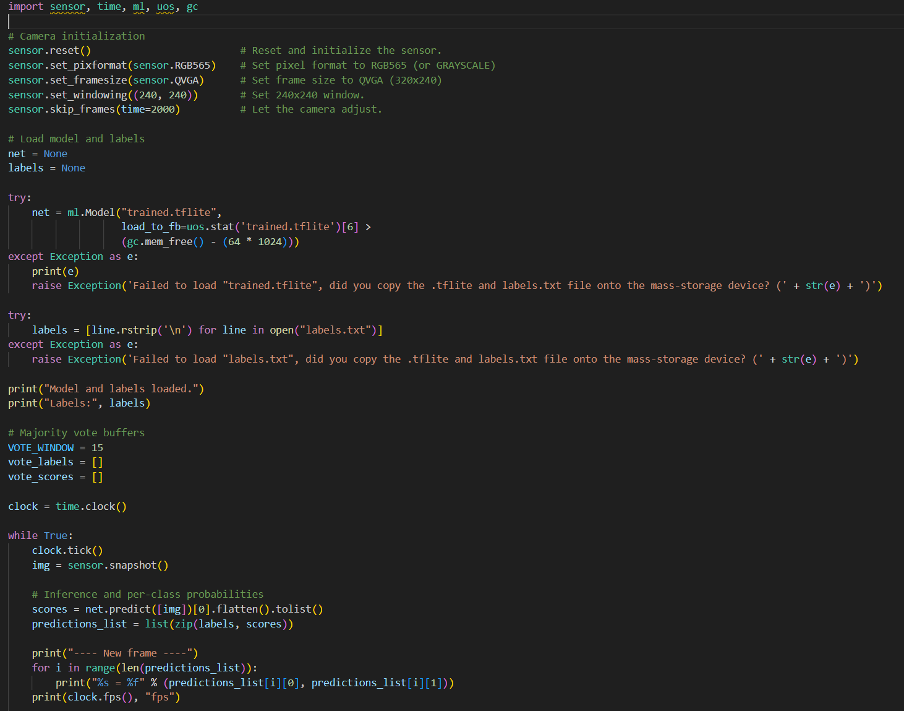
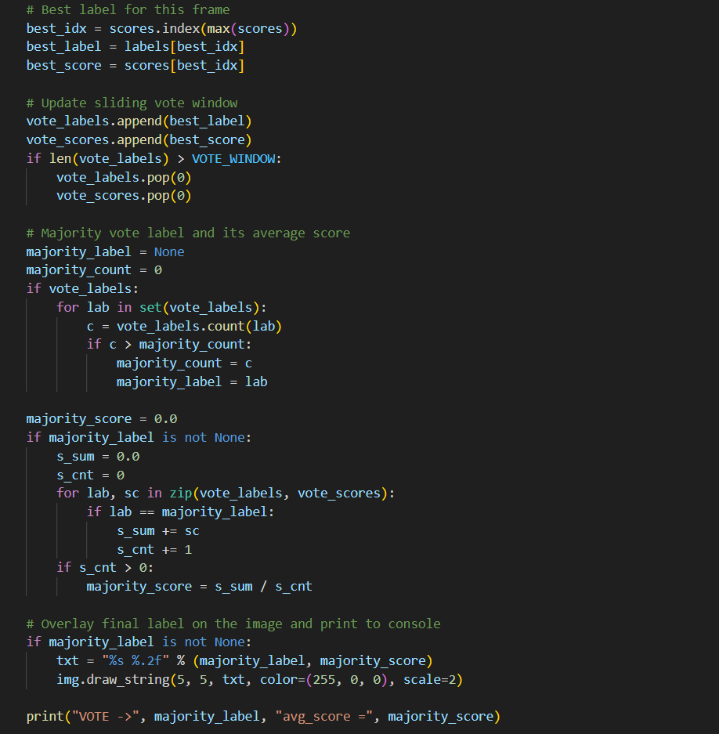
5
On-device Real-time Inference Pipeline
Block 1 — Setup: camera + model loading
Initialize the camera stream (format/size/crop), then load the TFLite model (trained.tflite) and the class list (labels.txt). This prepares the device for real-time inference.
Block 2 — Per-frame inference and raw output
For each frame, the code runs net.predict([img]) to get per-class probabilities, prints them, and reports FPS. This is the “raw” frame-level classification signal.
Block 3 — Sliding-window majority vote (stabilization)
The best label from each frame is pushed into a fixed-length window (VOTE_WINDOW). The final output label is the most frequent label in the window, which reduces jitter from noisy single-frame predictions.
Block 4 — Final display and reporting
Compute the average confidence for the voted label within the window, overlay “label + avg_score” on the live image, and print the voted result to the console for debugging/demo.

Slide 18
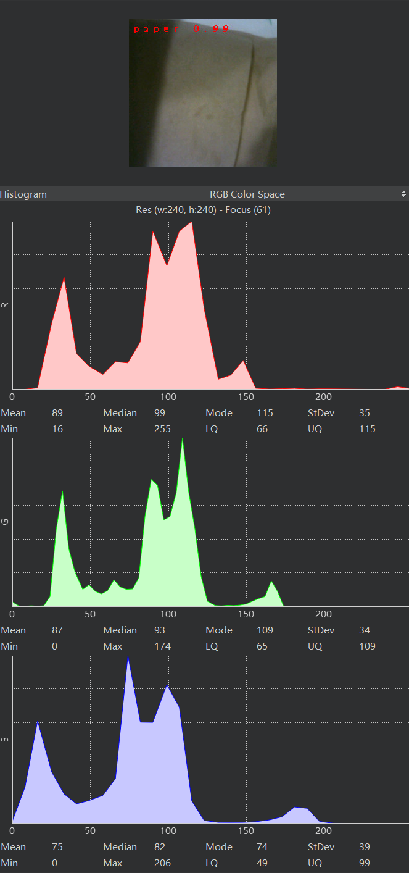
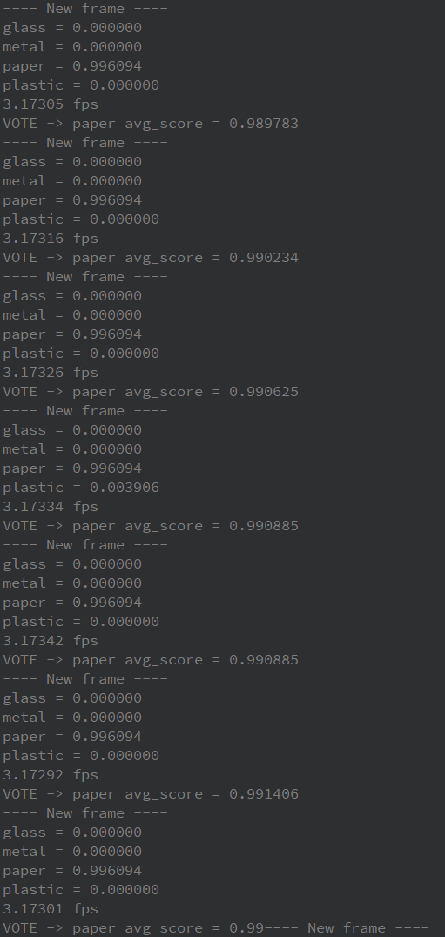
5
Results – Paper
Case 1 – Paper Tissue (Correct Classification)
Final label: Paper (majority vote)
Confidence: avg_score ≈ 0.99 (example from demo)
Speed: ~3.17 FPS (device-side, live stream)
Paper tissue is recognized accurately and efficiently in real time, with stable predictions enabled by majority voting.

Slide 19
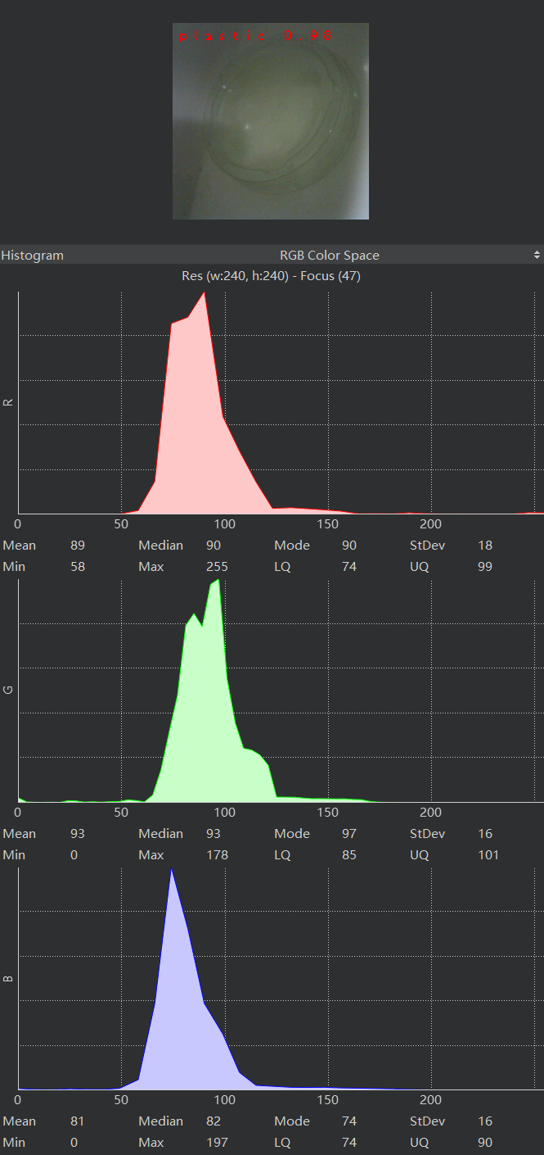
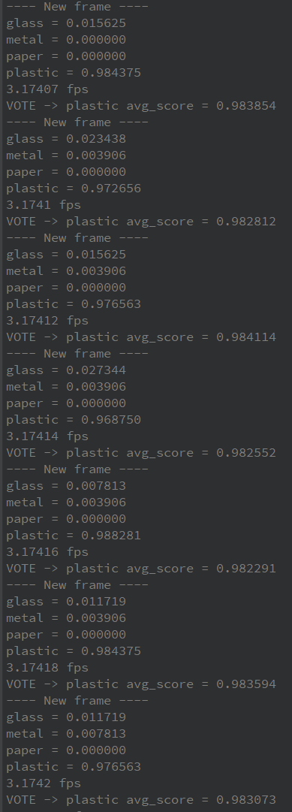
5
Results – Plastic
Case 2 – Plastic lid (Correct Classification)
Final label: Plastic (majority vote)
Confidence: avg_score ≈ 0.99 (example from demo)
Speed: ~3.17 FPS (device-side, live stream)
Paper tissue is also recognized accurately and efficiently in real time, with stable predictions enabled by majority voting.

Slide 20
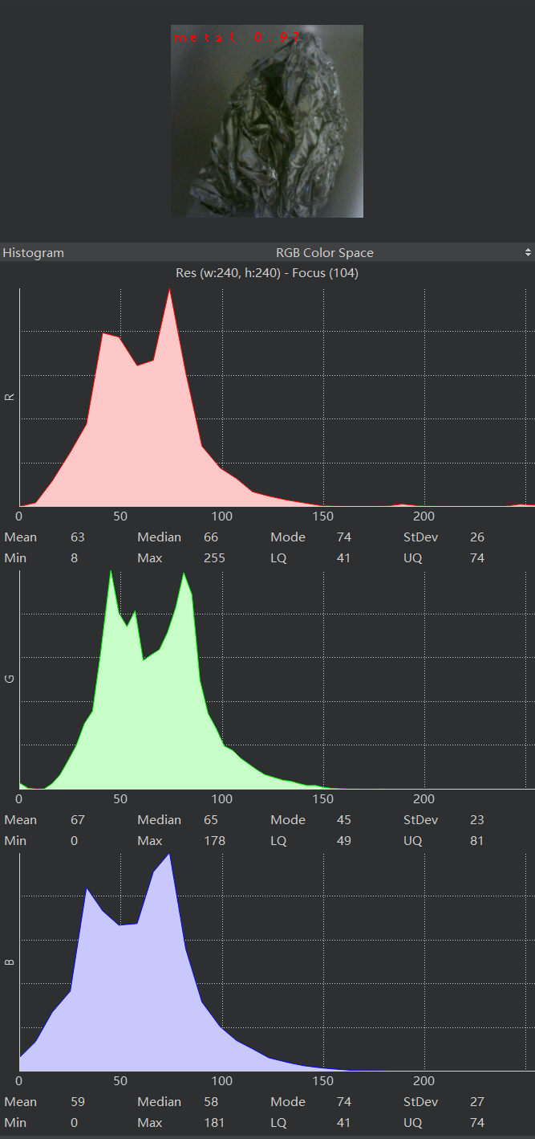
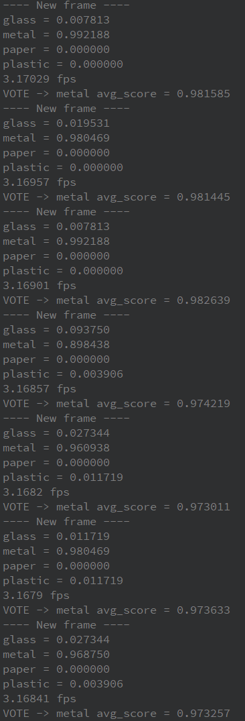
5
Results – Metal
Case 3 – Aluminum foil ball (Correct Classification)
Final label: Metal (majority vote)
Confidence: avg_score ≈ 0.97 (example from demo)
Speed: ~3.17 FPS (device-side, live stream)
Metal is a relatively more challenging category to recognize due to reflections and appearance changes, but the system still achieves correct real-time identification, with stable predictions enabled by majority voting.

Slide 21
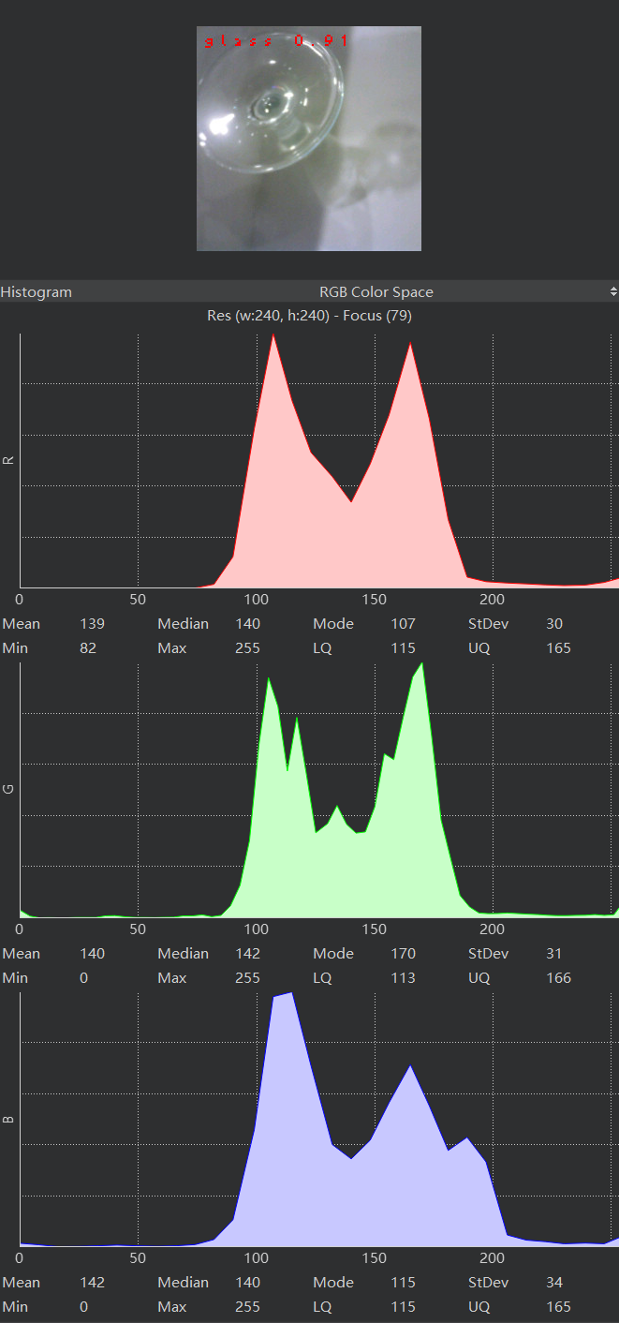
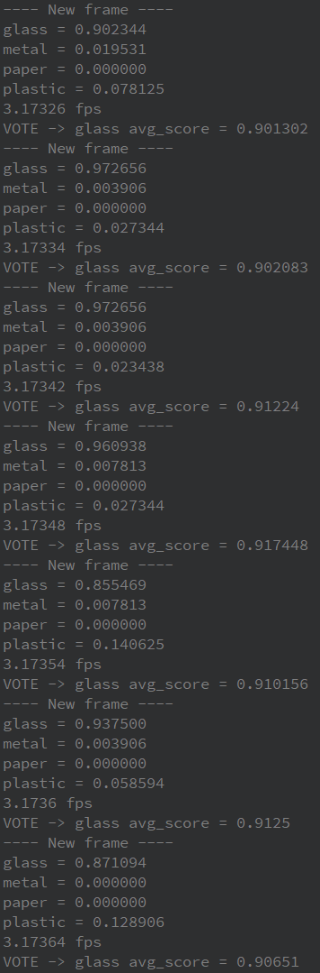
5
Results – Glass
Case 4 – Glass Cup (Correct Classification)
Final label: Glass (majority vote)
Confidence: avg_score ≈ 0.91 (example from demo)
Speed: ~3.17 FPS (device-side, live stream)
Glass is a challenging category to recognize because it is transparent and highly sensitive to lighting and reflections, but the system still achieves correct real-time identification, with stable predictions enabled by majority voting.

Slide 22
5
Results Summary
Paper & Plastic:
Most stable and accurate in our demos—high confidence and quick convergence with majority vote.
Metal:
More variable due to reflections and viewpoint changes, leading to less consistent probabilities.
Glass:
Hardest category—transparency and background/lighting dependence make predictions fluctuate.
Overall:
The observed performance gap is paper/plastic (easier) vs. metal/glass (harder) under real on-device conditions.

Slide 23
06
Conclusions ＆Limitations

Slide 24
6
Conclusions
We demonstrate feasible real-time waste classification on a low-cost MCU platform under tight compute/memory constraints.
What we built
What we achieved
End-to-end edge AI waste classifier: dataset → training → deployment → live inference
On-device pipeline on OpenMV H7 (camera capture + preprocessing + TFLite inference)
Stabilized real-time predictions using sliding-window majority vote
Validation accuracy: ~72.1% on TrashNet (4 classes)
On-device speed: ~3.17 FPS (live stream on OpenMV H7)
Footprint fits MCU constraints: ~215 KB peak RAM, ~536 KB flash

Slide 25
6
Limitations + Future Work
Limitations
Domain shift: TrashNet images differ from real on-device scenes (lighting/background), reducing robustness.
Hard classes: Metal & glass are sensitive to reflections/transparency → higher confusion vs. paper/plastic.
Real-time constraint: End-to-end speed is ~3.17 FPS, limited by capture + preprocessing + inference + display/printing.
Future Work
Data (reduce environment impact)：Collect in-domain images under target conditions (multiple lighting/backgrounds, real objects).
Model (improve metal/glass)：Tune augmentation for reflections/low-light (brightness/contrast, blur, background clutter).
System (improve FPS & UX)：Measure latency breakdown and optimize bottlenecks (reduce printing/overlay cost, streamlined preprocessing).
OUTPUTS
Next, we will focus on improving reliability through better data coverage and MCU-aware tuning.

Slide 26
Thanks for listening
Course: AI Hardware
Members: Mengzi Cheng, Shuai Tu, Sirui You, Xueyi Zhang
Team Name : Circuit Board Layout
Date: December 2025

